Slide 1
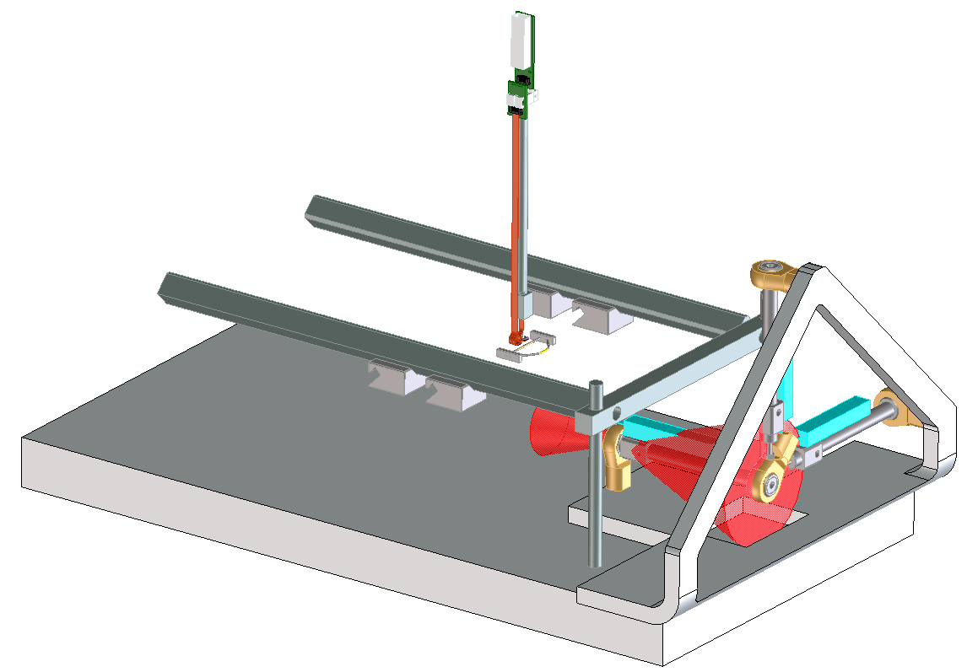
LBNL BARF Sensor N.Andresen 01/12/15
Sensor probe assembly
Pneumatic reward control assembly
Head clamp
Stereotaxic assembly

Slide 2
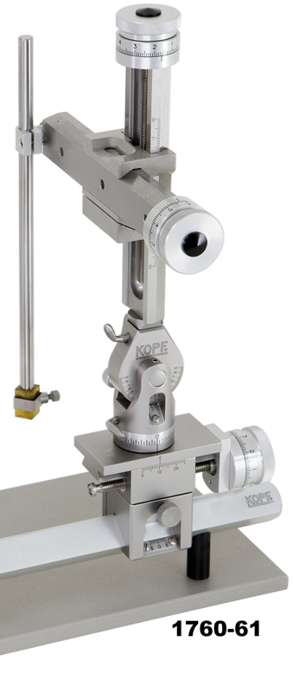
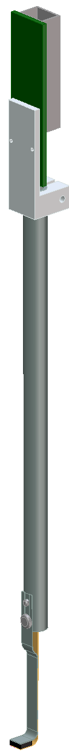
LBNL BARF Sensor N.Andresen 01/12/15
Connector
8”
Sensor rod
Sensor

Slide 3
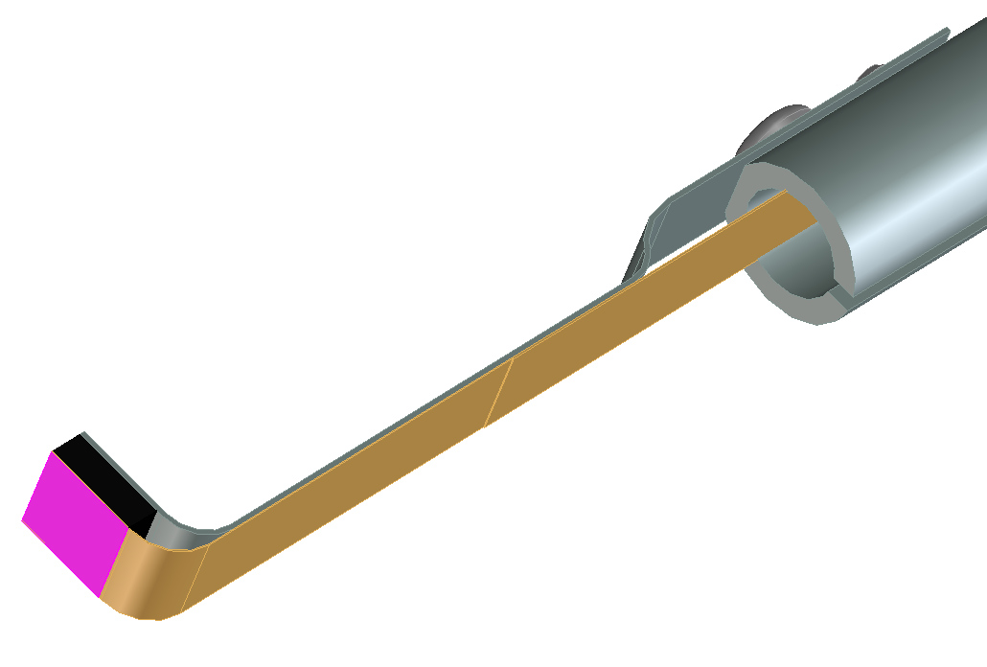
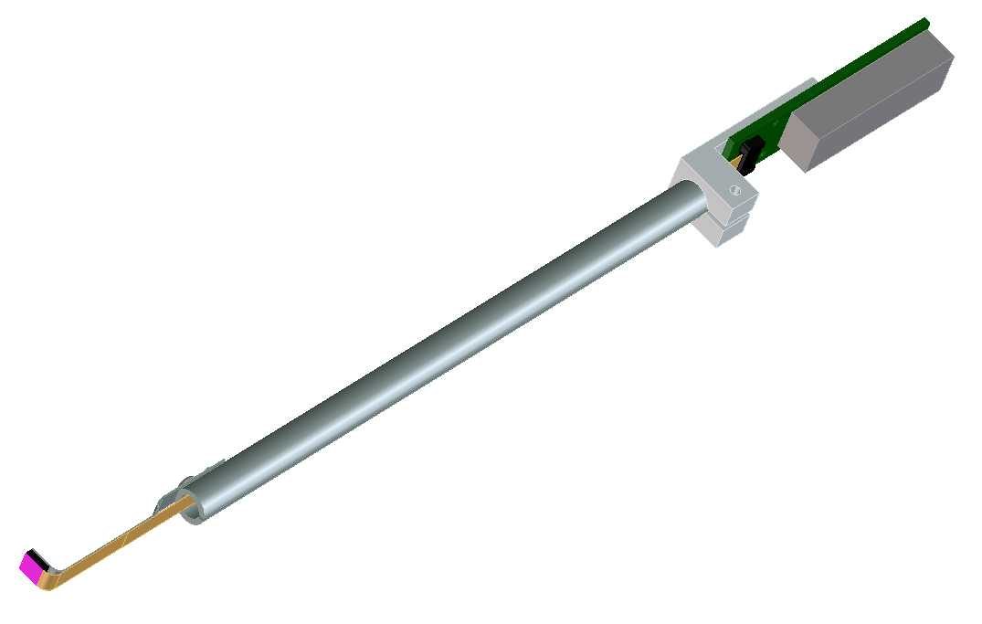
LBNL BARF Sensor N.Andresen 01/12/15
Stainless backing
fastener
I/O electrical connector
Ribbon connector
Stainless backing
Sensor
Flex-circuit
Foam backing

Slide 4
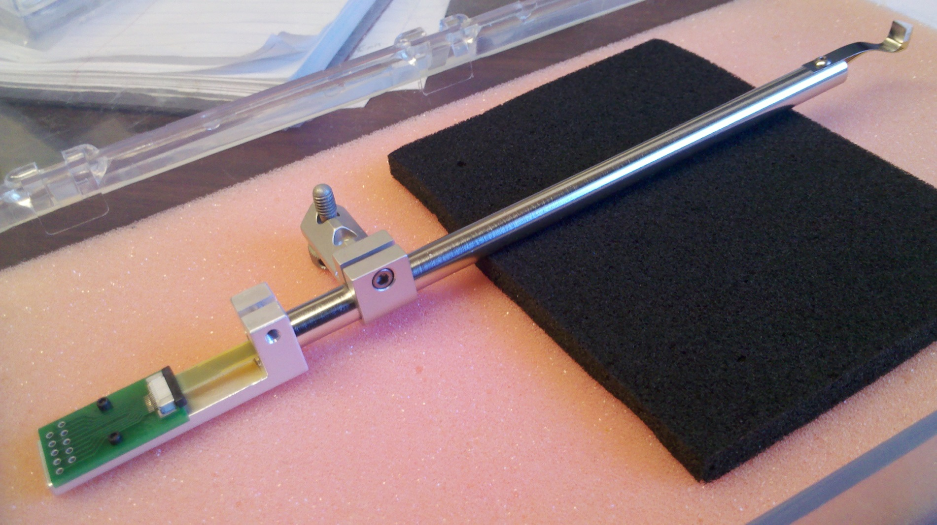

Slide 5
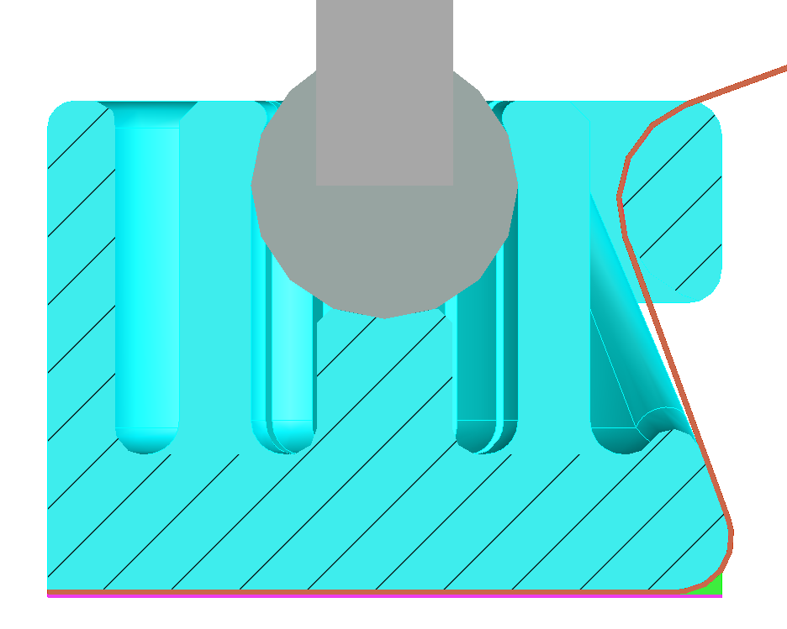
LBNL Brain Sensor Head Assembly N.Andresen 08/03/16
Chip holder
Sensor width max.
Flex-circuit
Epoxy gap fill
TSV zone
Sensor

